Slide 1
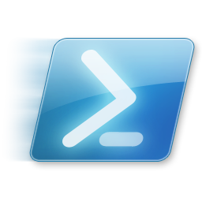
Windows PowerShell
System administration and automation in a Windows environment
-Visual Studio Code-
Jochen Mariën

Slide 2
Visual Studio Code
Visual Studio Code is the new cross-platform multi language editor by Microsoft
It’s being used for web (html and javascript), python, …
It has intellisense for any language (through extensions)
And it has integrated source control using Git
Notes:
$

Slide 3
Should you continue?
When should you switch to VSCode?
When collaborating
When writing large scripts
When maintaining large libraries of scripts
When working on multiple computers
When working on a Mac/Linux
When shouldn’t you use VSCode?
When quickly checking something
When writing a script on a server for that server
Notes:
https://github.com/PowerShell/PowerShell/blob/master/docs/learning-powershell/using-vscode.md
https://blogs.msdn.microsoft.com/powershell/2015/11/16/announcing-powershell-language-support-for-visual-studio-code-and-more/

Slide 4
You shouldn’t be writing scripts on servers!
Assuming you need to do AD-stuff
Aka you need resources and modules from a server
Option A:
Install the AD-module locally
Create a drive to the AD you want to edit
Option B:
Remote into a DC of the AD you want to edit
Advantages
Test in the testing domain, deploy on production without moving the script
The script stays in a location where you’ll be able to find it later on (Git?)

Slide 5
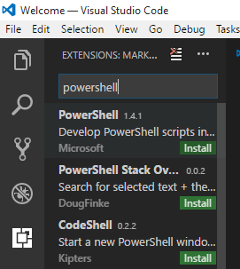
Installation
Download Visual Studio Code, and install
Download Git for windows, and install
Lots of next
The introduction-html pages open after installing, and you should read that
In VSCode, add the PowerShell extension
Click the square-icon on the left
Search for PowerShell
Install the extension made by Microsoft
Click the blue “Reload” button that replaces “Install”
Notes:
https://code.visualstudio.com/
https://git-scm.com/download/win

Slide 6
Using VSCode locally
You can open a folder, and start using all the files
… or open a file, and start editing it
New file
Ctrl-N
Save as .ps1 or…
Click “plain text” in the bottom right corner
Type and select “PowerShell”
Run the script:
One line: F8
The entire script: Ctrl-F5
Try to avoid when creating scripts
(Ok when script is done)

Slide 7
Using github
Git is not an extensions, but an integral part of VSCode
It’s a versioning tool, meant for many programmers to collaborate on the same codebase
Has features to allow merges of documents altered in different locations
Person X removes line 5
Person Y changes line 17
Person Z add text at the end
Git is more than Github
Github is a service that implements Git
You can run a private server

Slide 8
Logging on to Git
Once you’ve installed Git, you have to logon
Or configure username and email in git
This is done in a Git-tool, not vscode
Open a commandprompt and type…
git config --global user.name “Your User Name"
git config --global user.email aRealEmailAddress@server.com
When committing or the first time, a password will be asked (and stored)
Notes:
https://git-scm.com/book/en/v2/Getting-Started-First-Time-Git-Setup

Slide 9
How git works (simply put)
Working tree
(Files you create, edit, run, …)
Add (done automatically)
Staging area
(A list of all files you changed in the working tree)
Clone (copy online rep locally, and create new working tree)
Commit (commit-message is required)
Local repository
(Should mirror the online repository)
Pull (get changes from online
rep to merge with local rep)
Push
Github
(The website)

Slide 10
Starting off
Open VSCode
Click View – command palette (Ctrl-Shift-P)
Type “Git: Clone”
As URL, type https://github.com/mjochen/PS-Basic-course and enter
Choose the local folder to create the working tree
A subfolder is automatically created
You can choose to open the rep (bottom right)

Slide 11
Working…
After cloning, you can work in the working tree
Change, create, … files
When done you can stage, commit and push
But you won’t be able to push, because to commit you have to be a contributor
You can always push to another rep

Slide 12
Alternative
Download the rep as ZIP-file
Unzip into a directory
Open the directory in VSCode

Slide 13

Do I need VSCode?
No, only for the .md-files
MD: Markdown
ASCII-based files with minimal encoding that can be rendered as ‘good looking’-text files
All exercises are in markdown
To get the ‘good looking’-version:

